Slide 1
Module 4: How Clients Access Siebel Data
Siebel Core Developer and Technology School
Notes:
Time: Lecture: 30 minutes; in-class discussion lab: 5 minutes
Intent: To introduce all of the Siebel clients and describe how each of them accesses Siebel Servers, services, and data.
Flow: Overview of clients, client access overview; description of Siebel applications; overview of application components locations; introduction to each client; and an overview of all clients. Before the introduction of each client, a Siebel client scenario will be presented to relay the business reason for the use of the particular client.
Key Terms:
Siebel Web Client
Siebel Wireless Client
Siebel Handheld Client
Siebel Mobile Web Client
Siebel Dedicated Web Client
Disconnected processing
Please note: Faculty-specific notes are italicized.

Slide 2

Module Objectives
After completing this module you will be able to:
  Identify the various Siebel clients
  Identify how each client accesses Siebel Servers and data
Why you need to know
  To deploy Siebel clients, you must understand the architecture that supports them and how each client accesses Siebel Servers and data
Notes:
Each objective and “why you need to know” should be stated aloud.

Slide 3
Siebel Clients: Overview
Use a standard Web browser to display the Siebel user interface (UI) containing data retrieved from the Siebel database
Access Siebel data differently based on client type
  Not all connect through Web server and Siebel Web Server Extensions (SWSE)
Siebel Web Client
Web Server
Siebel Gateway Name Server
Browser
SWSE
Enterprise
Siebel Server
Siebel File System
Server Components
Database Server
Notes:
This is a positioning slide, tying clients into the overall architecture seen in the last module.
Typically, Siebel clients use standard Web browsers. Not all are thin clients, however, and access to data differs depending on the client.

Slide 4




Siebel Clients: Overview Continued
Five types deployed in Internet or intranet environments
  Siebel Web Client
  Siebel Wireless Web Client
  Siebel Handheld Client
  Siebel Mobile Web Client
  Siebel Dedicated Web Client
Web
Wireless Web
Handheld
Mobile Web
Dedicated Web
Notes:
The following slides will address that not all clients support the same features, and their interactions with the Siebel architecture are also different.

Slide 5
Client Access Overview
Access to Siebel data differs based on client type
  Web and Wireless Web Clients connect through the Web Server
  Handheld and Mobile Web Clients connect through the Siebel Server
  Dedicated Web Client connects directly to the Siebel database
Web
Web Server
Siebel Gateway Name Server
SWSE
Wireless Web
Enterprise
Handheld
Siebel Server
Siebel File System
Server Components
Mobile Web
Database Server
Dedicated Web

Slide 6
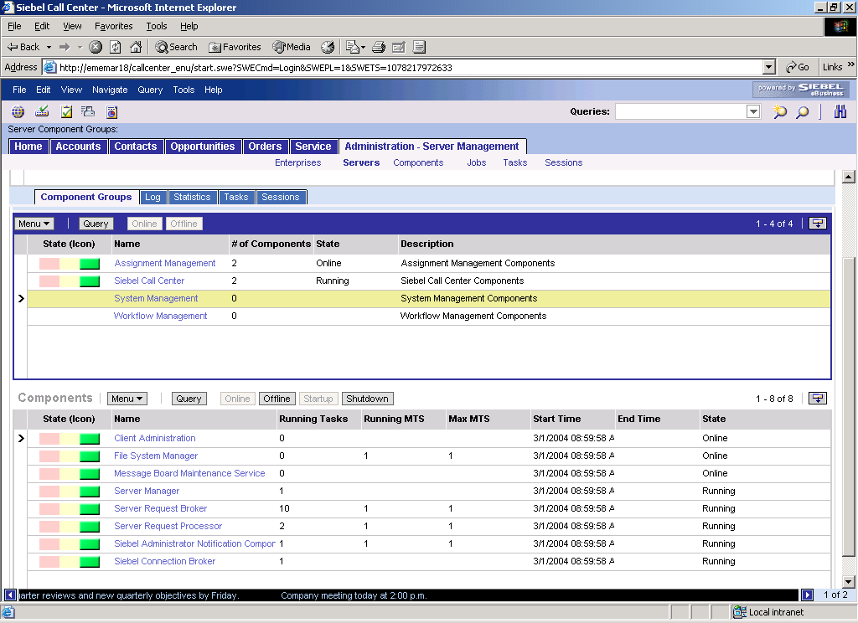
Siebel Applications
Consist of:
  An application object manager
  Configuration (.cfg) file or Application Object Manager (AOM) component parameters defining the repository file and database
  A repository (.srf) file that specifies the configured application
  A set of template files that specify how to render the UI in the user’s browser
  A relational database
Specified by data that is separate from the engine that executes the application
Web Clients
Mobile and Dedicated Web Clients
Application Object Manager
Component Parameters
Database Server
.CFG
.SRF
.SWT

Slide 7
Application Component Locations
For Web and Wireless Web Clients, all components reside on the server hosting the application
  No Siebel software installation is required
  Siebel applications run in standard browsers
For all other clients, all components reside on the computer hosting the client
  Siebel software installation is required
Application Object Manager
Component Parameters
Database Server
.CFG
.SRF
.SWT
Notes:
This slide summarizes the different locations of the application components depending on the client.
Connection state is stored on the Siebel Server.
Web and Wireless Web are thin clients. No software beyond the standard Web browser need be installed on the client.
To run the client in HI mode, an ActiveX control is automatically downloaded, and that the appropriate permissions to allow this need to be set on the client machine.

Slide 8
Configuration File and Component Parameters
Some clients obtain initialization settings from both the configuration file and Application Object Manager (AOM) component parameters
  Web Client
  Wireless Web Client
Some clients obtain initialization settings exclusively from the configuration file
  Mobile Web Client
  Dedicated Web Client
  Handheld Client
Web Clients
Mobile and Dedicated Web Clients
Application Object Manager
Component Parameters
Database Server
.CFG
.SRF
.SWT
Notes:
This slide differentiates clients according to where they obtain configuration parameters.
Contains initialization settings for the Application Object Manager, including:
Siebel Gateway Name Server
LDAP directory server
Enterprise Server
File system Repository (.srf) file
Database server (data source)
Application or server component

Slide 9
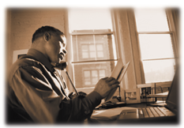
Siebel Client Scenario
Wayne is working from home. He would like to frequently and quickly view and update the activities of his assigned accounts. Since his computer has a browser, but no Siebel software, he types the appropriate URL to access the account data.
Wayne is using the Siebel Web Client

Slide 10
Web Client
Accesses Siebel Gateway and Siebel Server through Web Server running SWSE
Accesses Siebel data through AOM
  SWSE (eapps.cfg) parameters identify AOM
AOM component parameters specify Enterprise Server, Siebel Server, .cfg, and .srf the Web client uses
Siebel Web Client
Web Server
Siebel Gateway Name Server
Browser
SWSE
Enterprise
Siebel File System
Siebel Server
Application Object Manager
.CFG
.SRF
Database Server
Component Parameters
Notes:
Definition of Web client: Siebel Web Client runs in a standard browser on the end user’s client computer. ActiveX controls and Java Script routines are downloaded to the browser automatically when it runs Siebel applications in Siebel high interactivity mode. The browser connects through a Web server to the Siebel Server. Requests are processed by the Siebel Server, whose Siebel Web Engine builds HTML pages, which render the UI on the client. Requires only a standard browser.
The Web Client is a “thin” client. It indirectly talks to the Web server and Siebel Servers. The Web Client is a zero install client that is launched by typing a URL into a browser. That URL refers to a Web Server on which the Siebel Web Server Extensions have been installed. Those extensions specify a Siebel Gateway Name Server, a default Siebel Server (to use if load balancing is not in place), and the Application Object Manager component to use (for example, the Call Center Object Manager displays a different Application than the eSales Object Manager).
Web client uses Web browser to launch HTML page specifying .swe page. .swe page invokes the SWSE.
The Web server registry associates the file extension .swe with the SWSE, a program called sweiis.dll. This is similar to how your registry knows to launch MS Word when you open a file with a .doc extension or .xls opens up MS Excel.

Slide 11
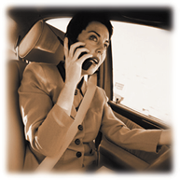
Siebel Client Scenario
Wendy is a salesperson. She has a meeting set up with one of her opportunities. Since she is running late, Wendy uses her Web-enabled phone to retrieve the meeting information from the Siebel database. As an outcome of the meeting, she updates the sales stage of the opportunity.
Wendy is using the Wireless Web Client

Slide 12
Wireless Web Client
Connects to a Wireless Application Protocol (WAP) server connected to a Web server with SWSE installed
Connects to a database server through the AOM
  Results are transformed and returned as WML pages
Siebel Wireless Web Client
WAP Server
Web Server
Siebel Gateway Name Server
SWSE
Enterprise
Siebel File System
Siebel Server
Application Object Manager
.CFG
.SRF
Database Server
Component Parameters
Notes:
Definition of Wireless Web Client: Siebel Wireless allows users to view, edit, and create records in the Siebel Database through a wireless connection between a mobile device and a Web server. An internet-enabled mobile phone, personal digital assistant or other device communicates using wireless application protocol (WAP) to a wireless gateway server. The wireless gateway server translates HTTP messages to WAP. The Siebel interface is rendered on the mobile device using wireless mark-up language (WML). Specific XML- and HTTP-based wireless browsers are also supported. Requests are processed by Siebel Server, whose Siebel Web Engine builds HTML pages, which comprise the client.

Slide 13
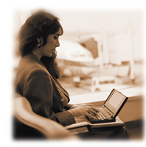
Siebel Client Scenario
Mary is a consultant. She is at the airport waiting for her flight and would like to access contact information for an active opportunity. Since she can not access the server, she is retrieving this information from a local database on her laptop.
Mary is using the Mobile Web Client
(This scenario also applies to the Handheld client if a handheld device was used.)
Notes:
Siebel Handheld Client runs on a handheld device that supports the Windows CE operating system.

Slide 14
Handheld and Mobile Web Clients
Access local .cfg and .srf files
Directly access a local database and Siebel File System
Directly connect to their designated Siebel Server for synchronization
Enterprise
Siebel Server
Mobile/Handheld Client
Synchronization Manager
.CFG
.SRF
Application Object Manager
Database Server
Siebel File System
Notes:
Definition of Handheld Client: Is a streamlined version of the Siebel Mobile Web Client. It includes only the functionality required by end users’ field technicians. The Siebel Handheld Client supports the same data relationships, the same configuration in Siebel Tools, and much of the same functionality as the Siebel Mobile Web Client. Siebel Handheld runs on devices that support the Windows CE operating system.
Definition of a Mobile Web Client: Typically runs on a laptop.
Applies to both Handheld and Mobile Web Clients: Connects directly to the Siebel Servers to synchronize local database with Database Server. During disconnected processing, runs local Application Object Manager, Data Manager, and Web Engine, writing transactions and files to local database and file system.
The Mobile Web Client is a “thick” client, meaning you run it by going to Start > Programs > Siebel Client 7.5. If you then choose to log into the local database, you will connect directly to the connect string specified in the [Local] section of the .cfg file (for example, c:\sea77\client\local\sse_data.dbf). When you are logged into a local database, the thick client (Mobile Web Client) is allowed to Synchronize. This synchronization takes place to the Siebel Server designated in the .cfg file, and cannot be load balanced because each mobile client's inbox and outbox are on one and only one Siebel Server.

Slide 15
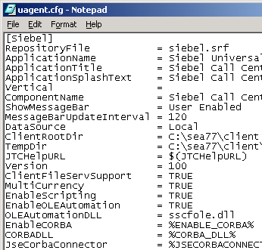
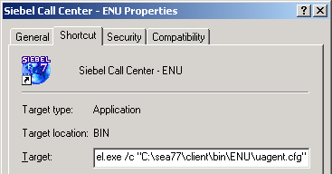
Mobile Web Client
Siebel.exe is launched from program group or startup icon
Startup switch identifies .cfg
.cfg identifies .srf, application, local database, and Siebel Server
Mobile and Handheld are not zero-footprint applications
Notes:
This slide describes the path by which Handheld and Mobile Web Clients connect to the object manager on the correct Siebel Server with the correct SRF.
Mobile and Handheld Clients have a built-in version of the Web server and SWSE. A web server, such as a personal Web server, does not need to be installed on your machine. This functionality is essentially written into the Siebel executable.
The Handheld client does not run via a browser. It is a native installed application that runs either on the Win CE/Pocket PC or Palm OS platform. The handheld application is not a thin client application.
FAQ:
Q: When accessing Siebel from a desktop icon (vs. typing in the URL from Internet Explorer) how does the shortcut point to the appropriate .swe URL?
A: The desktop icon would refer to the Mobile Client. For example:
D:\sea77\client\BIN\siebel.exe /c D:\sea701\client\bin\ENU\uagent.cfg /d sample /u SADMIN /p SADMIN.
The Mobile Client starts up its own application object manager etc., so you don't need to specify a URL.

Slide 16
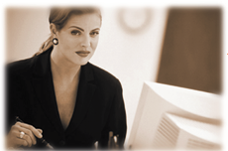
Siebel Client Scenario
Dana is a system administrator. She has the client software installed locally because she requires access to the application even when the servers are not available.
Dana is using the Siebel Dedicated Web Client
Notes:
The Dedicated and Mobile Web Clients use the same executable.

Slide 17
Dedicated Web Client
Uses a locally installed executable (siebel.exe) to support dedicated access to the database
  No requirement for Web Server or SWSE
  Not a zero-footprint application
Enterprise
Dedicated Web Client
Siebel Server
.CFG
.SRF
Application Object Manager
Server Components
Database Server
Siebel File System
Notes:
Definition of Siebel Dedicated Web Client: Microsoft Windows client delivered through a Web browser that provides direct connectivity to a database server. It requires software to be installed on the client machine, but does not require a local database, Web server, or Siebel eBusiness Application server for serving up interactive user sessions. Siebel Server is still required for functionality like Assignment Manager and Replication. The software installed on the user's machine for the Siebel Dedicated Web Client and Siebel Mobile Web Client is identical. The only difference is the type of connectivity provided.
The Mobile Web Client connects to a local database and the Dedicated Web Client connects directly to the server database. If you choose to log into the 'Server' database, you connect directly to the database server (for example, via an ODBC Data Source). The Dedicated Web Client is not able to synchronize. It also does not need to talk to the Siebel Gateway and Siebel Servers. As a thick client, it is able to get data directly from the database. The only time the Dedicated Web Client talks to the Siebel Gateway and Siebel Servers is when the user navigates to a server administration screen.
Note: Although the Dedicated Web client has direct access to the database, it does not have full (server) functionality.

Slide 18
All Clients
Siebel architecture supports a mixture of clients
Siebel Wireless Web Client
WAP Server
Web Server
Siebel Web Client
SWSE
Browser
Siebel Gateway Name Server
Enterprise
Dedicated Web Client
Siebel Server
Mobile/Handheld Client
Server Components
Application Object Manager
Application Object Manager
Application Object Manager
Component Parameters
.CFG
.CFG
.SRF
.CFG
Database Server
Siebel File System
.SRF
.SRF
Notes:
This slide summarizes the clients and their access to services and data. Note that the Mobile and Handheld Clients have all the local processing evident in the depiction of the Dedicated Web Client, which they use during disconnected processing.

Slide 19
Summary
This module showed you how to:
  Identify the various Siebel clients
  Identify how each client accesses Siebel Servers and data
Notes:
Review Questions
Question: For which clients are configuration parameters specified on the Application Object Manager?
Question: When a client connects through the Web server, how is the Application Object Manager name determined so that the request can be submitted properly?
Question: Several clients have local Application Object Managers. Which are they, and what are they used for in each case?
Question: What are the five things we need for every Siebel application?

Slide 20
Lab
Which client is best suited for:
  Disconnected remote users needing access to their data
  User with cell phone needing access to their data
  Users needing frequent and fast access to their data (easily scalable and maintained)
  Server administrator needing access (to shut down a server component)
Notes:
This lab is a short class discussion, there is no lab worksheet or solution provided.
Disconnected remote users needing access to their data
(Mobile Web Client and Handheld Client)
User with cell phone needing access to their data
(Siebel Wireless Web Client)
Users needing frequent and fast access to their data (easily scalable and maintained)
(Siebel Web Client)
Server administrator needing access (to shut down a server component)
(Siebel Dedicated Web Client)

